Slide 1
CS225-226 Project :-
Arduino Nano Based “Lie Detector”
Made By :
Himanshu Garg
1901CS25

Slide 2
MOTIVATION:-
There are a lot of small things for which we lie in our daily lives, like why we got late, who broke the glass, who ate the ice-cream, etc. So, in order to figure that out, I made a small portable lie detector for myself. So if someone lies to me, I can check on it 😊….

Slide 3
INTRODUCTION:-
Lie Detector is a fun, digital-design arduino based project. Usually when someone lies, they get nervous. That is the “fundamental idea” of my lie detector.
Our skin is amazing! It provides a medium for us to experience the sense of touch, it keeps infections out and not only that, our skin changes conductivity depending on many different things, one being our mood. It is called Electro Dermal Activity (EDA). EDA is the property of the human body that causes continuous variation in the electrical characteristics of the skin.
The traditional theory of EDA tells that skin conductance varies with the state of sweat glands in the skin. Sweating is controlled by the sympathetic nervous system, so whenever we get nervous, our sweat gland activity also increases, which in turn increases skin conductance. In this way, skin conductance can be a measure of emotional and sympathetic responses. More information can be found here - https://en.wikipedia.org/wiki/Electrodermal_activity
So if someone tries to lie with his/her fingertips connected to the lie detector and he/she gets nervous, then the skin conductivity will increase suddenly which can be noticed in the serial plotter in the Arduino IDE and the Red LED will start glowing thus indicating that the subject is trying to lie.

Slide 4
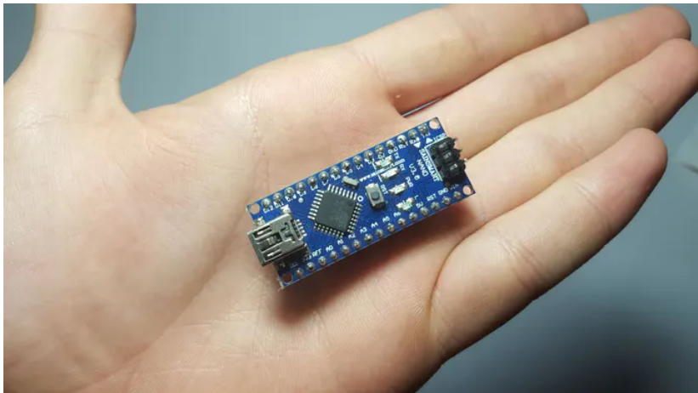
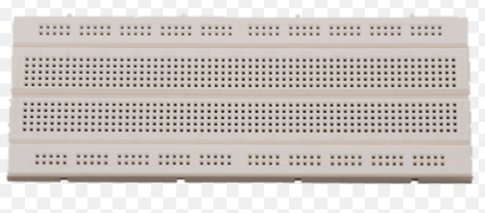
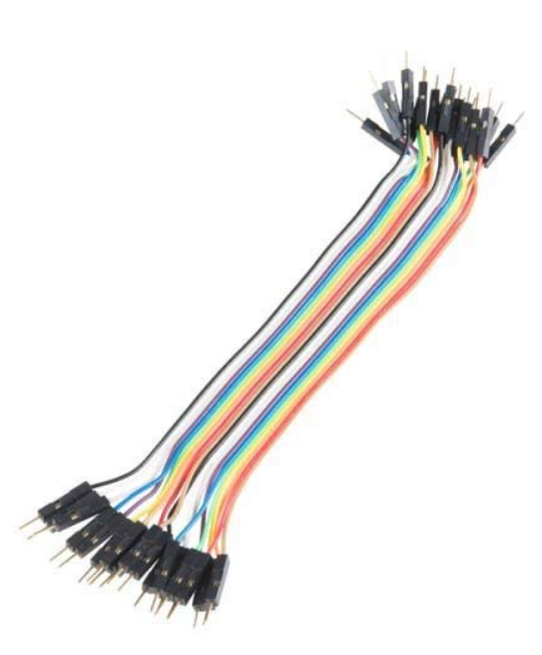
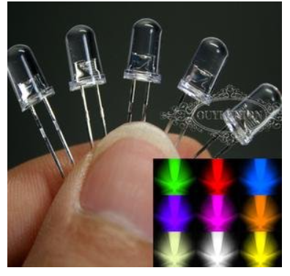
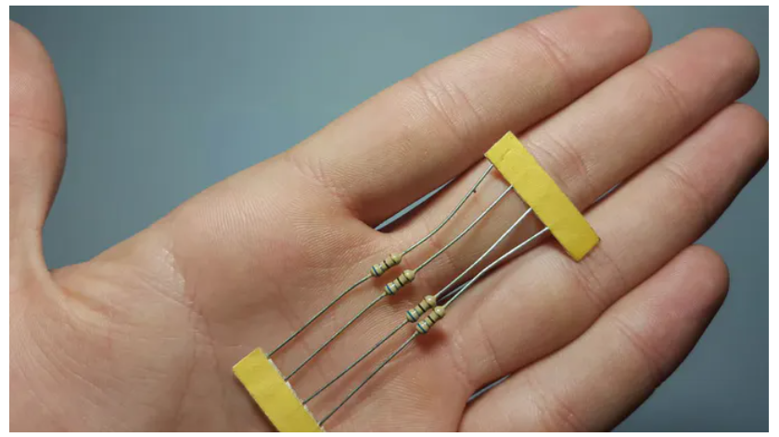
Components & Supplies:-
Breadboard
Arduino Nano
Green, Orange and Red LEDs
1800 ohm resistor
Cables

Slide 5
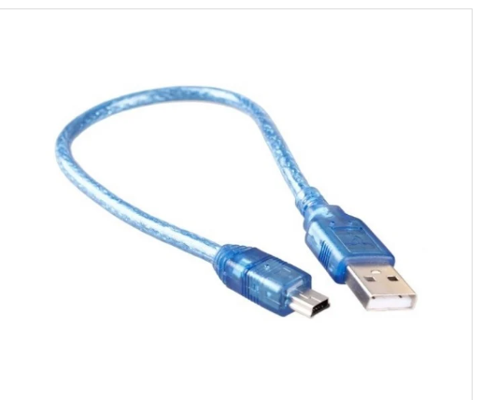
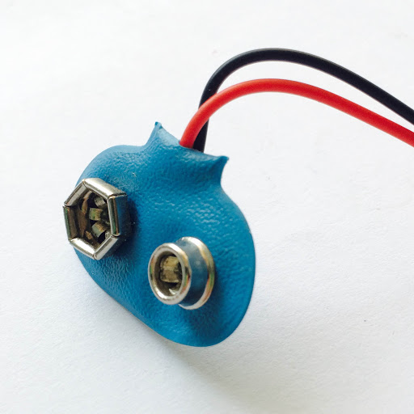

Continued…
Type A to mini B USB cable
Battery Cap
Apps and Online Services:-

Slide 6
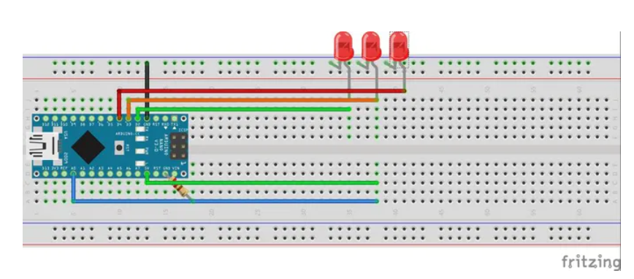
Block Diagram :-

Slide 7
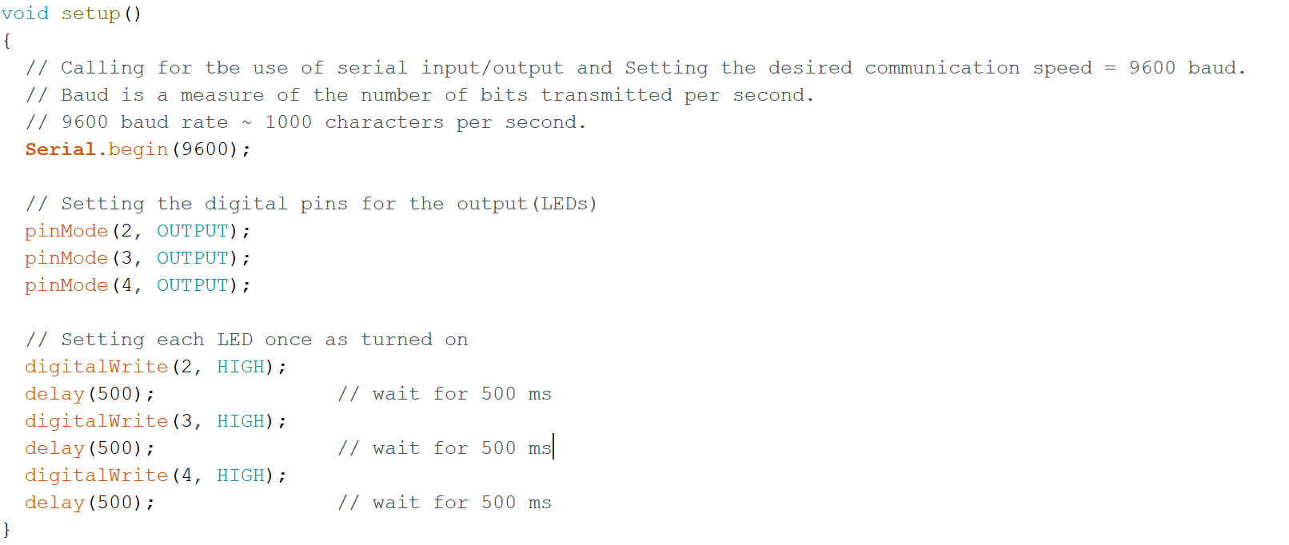

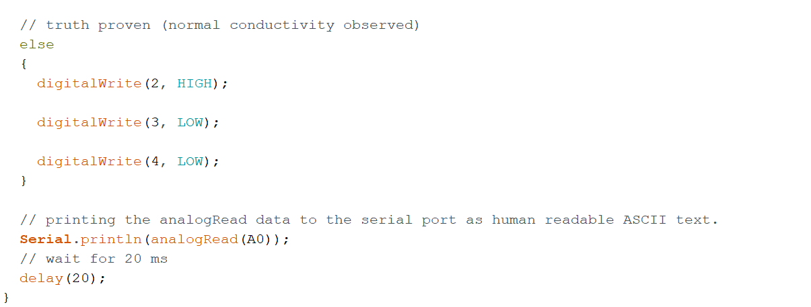
Software & Code:-
The main piece of software I used is the newest version of Arduino IDE.
I connected my Arduino Nano with my laptop using a data cable and then uploaded the code on it.
I have added comments within the code for clear understanding.

Slide 8
TESTING:-
The Arduino Nano is powered by a data cable from the laptop, and it uses the power to maintain a constant potential difference across the part of skin connected to the circuit using battery cap probes.
We start by asking some simple questions from our subject such as name, age, etc.. and observe the graph in the serial plotter in Arduino IDE to get the base line of the skin’s current conductivity and upload the corresponding valued code to the arduino board. Later, we can start asking other questions to our subject for which he/she may lie about. When the subject lies, he/she will “probably” feel nervous and the value in the graph will increase sharply and the red led starts glowing thus we can conclude that he/she is lying.

Slide 9
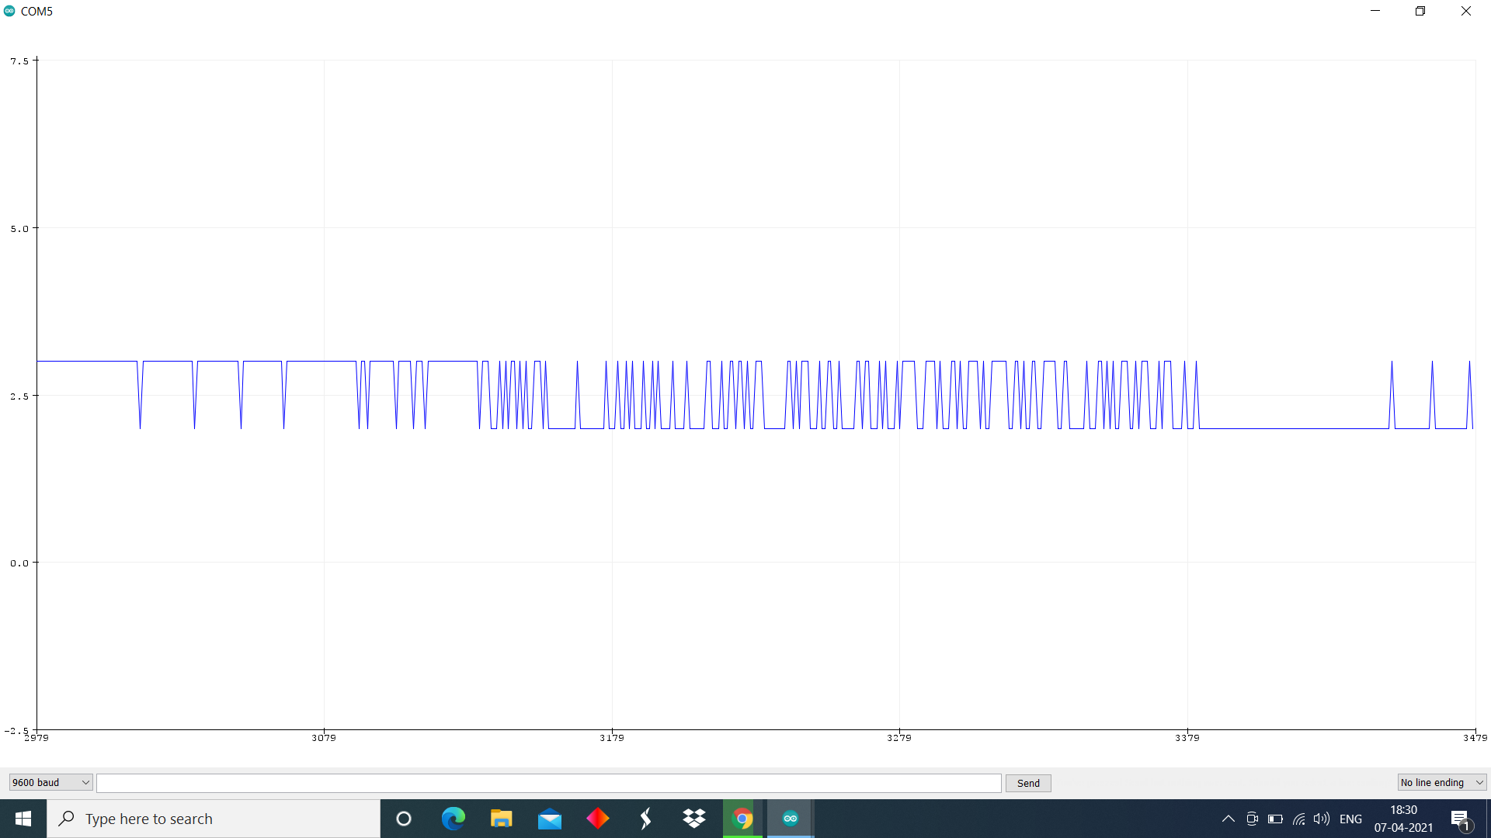
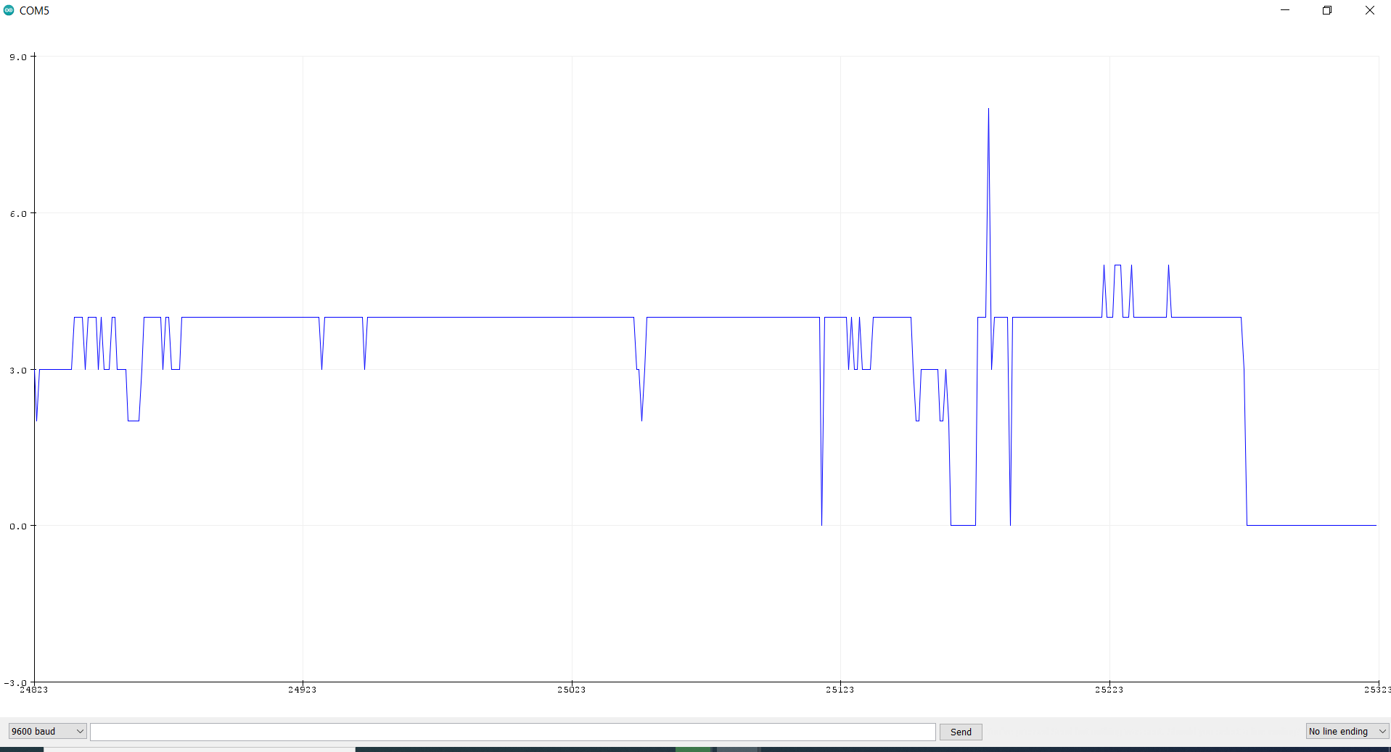
Serial Plotter graphs
My Normal skin conductivity
My conductivity when I got a bit nervous, (slightly higher than before)

Slide 10
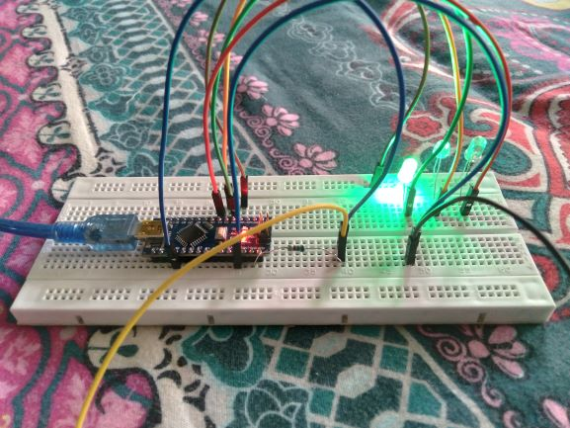
Working Lie Detector:- 1. Truth proved ☺

Slide 11
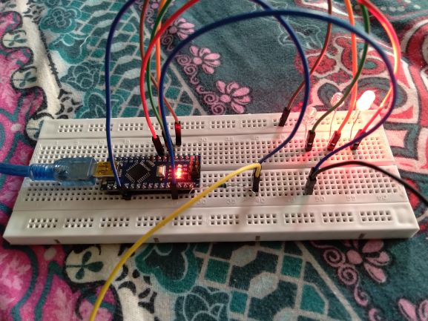
2. Lie Caught ☹

Slide 12

THANK YOU !
My demo video:-
The video can be played by clicking on the above box during the slide show
Made By-
Name – Himanshu Garg
Roll number –1901CS25

